Slide 1


US Census Demographic Analysis
Tableau project

Slide 2
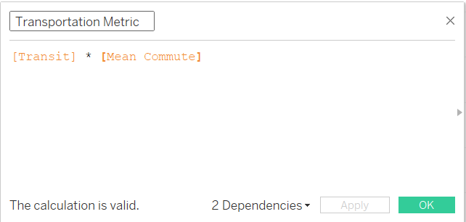
Transportation Metric
This metric combines the percentage of people using public transit with the average commute time.
A higher value could indicate either a high reliance on public transit with longer commutes or a high percentage of people using public transit but with shorter commutes.

Slide 3
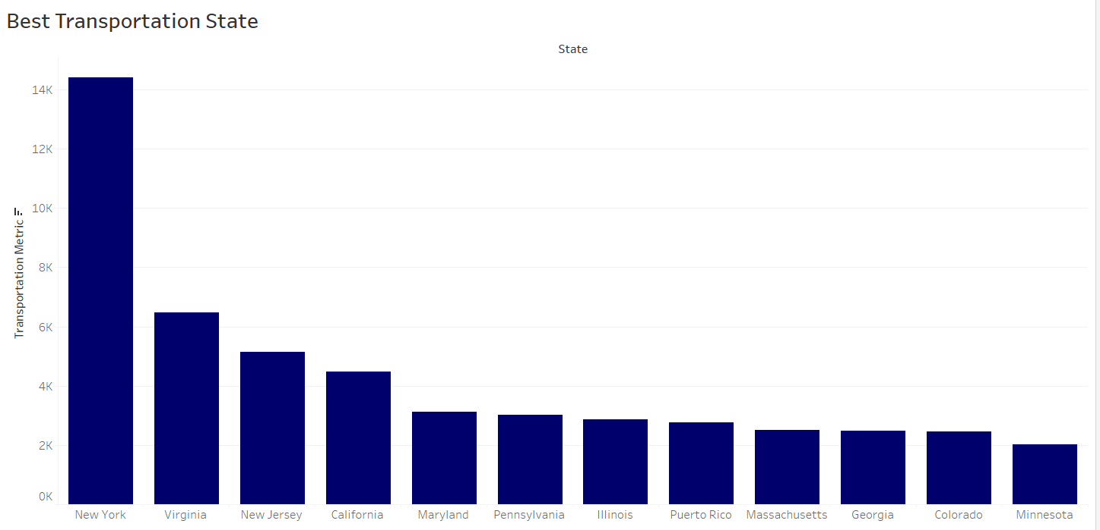
How do states compare in terms of transportation metrics?
New York appears to have the highest "Transportation Metric" value, indicating the best transportation performance among the states shown.
Minnesota appears to have the lowest "Transportation Metric" value, indicating the lowest transportation performance among the states shown.
Reasons to choose: The bar chart effectively visualises the variation in transportation performance across different US states, allowing for easy comparison and identification of states with the best and worst performance.

Slide 4
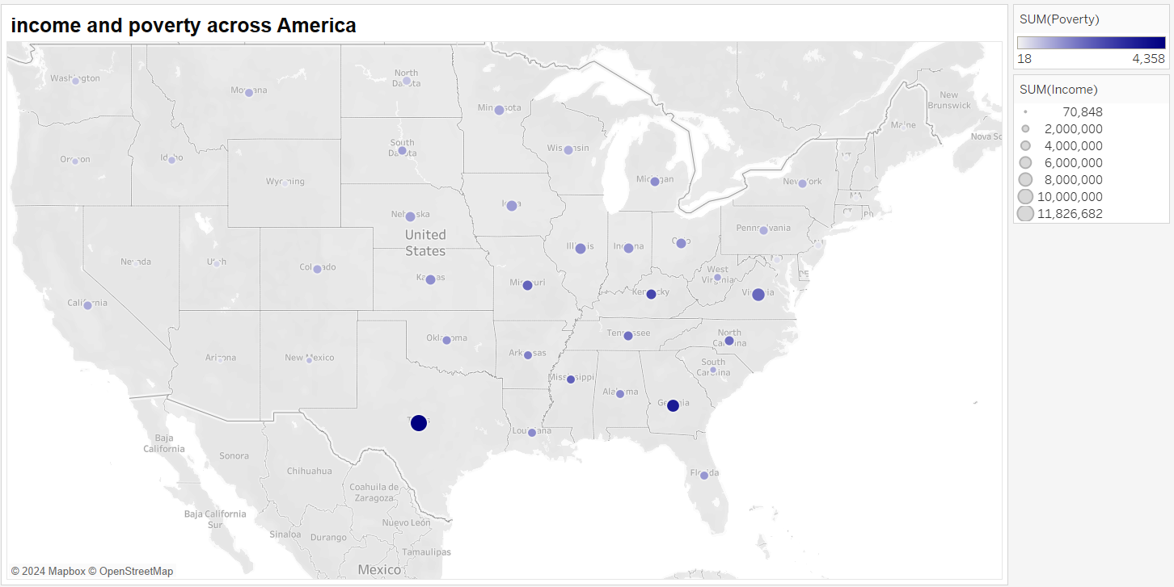
How does income or poverty vary geographically across America?

Slide 5
Geographical income & Poverty analysis
Income Distribution: The map highlights clear income disparities across the U.S., with higher incomes concentrated in the Northeast and West Coast, particularly in states like California and New York, represented by larger, darker blue circles. Conversely, the South and Midwest show lower income levels with smaller, lighter circles.
Poverty Distribution: High poverty rates are mainly seen in the South and Midwest, aligning with regions of lower income. Interestingly, even high-income states like California have pockets of significant poverty, especially in both urban and rural areas.
Geographical Insights: The map effectively shows income and poverty disparities, making it easy to identify high-income and high-poverty regions by state and geography.
Reason to Choose the Map: The map effectively visualizes income and poverty disparities across the U.S., enabling easy identification of high-income and high-poverty regions by state and geography, making it an ideal tool for understanding geographical patterns.

Slide 6
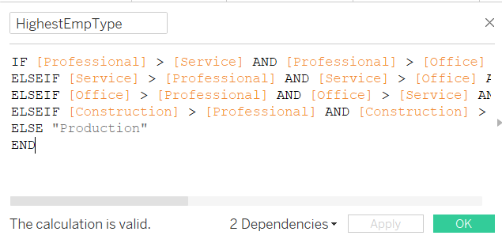
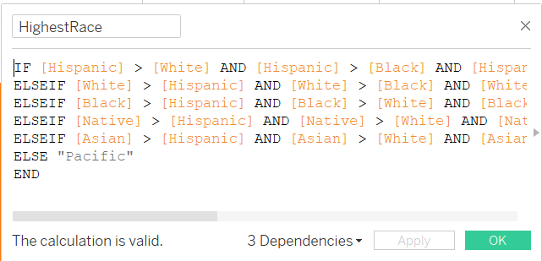
The HighestEmptype calculated field specifies the employment category with the highest workers in the state or country
The HighestRace calculated field specifies the race with the highest precedence in the state or country

Slide 7
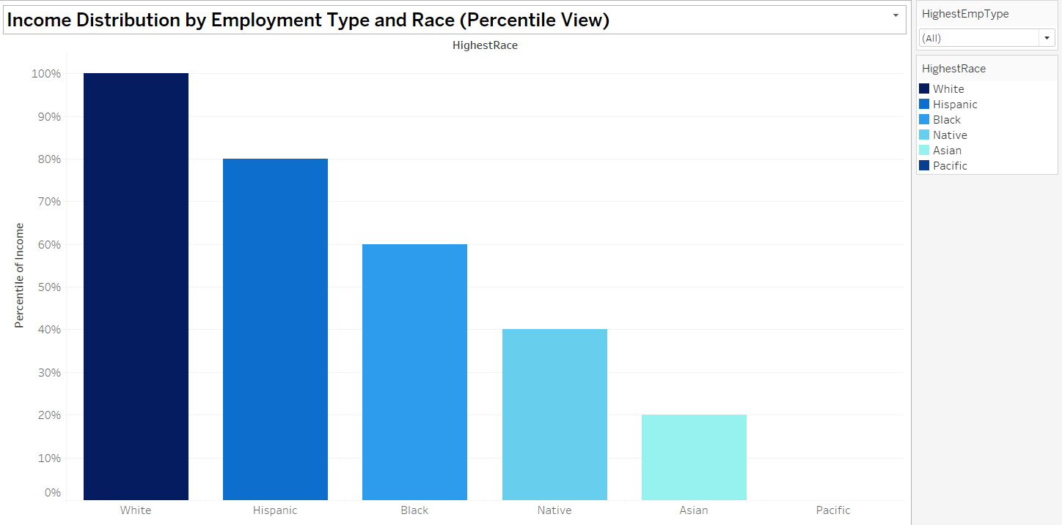
What is the distribution of income across different races and employment types?
Income Dominance:White and Hispanic individuals dominate the higher income brackets in Professional roles, while Black and Native individuals are underrepresented.
Professional and Office Roles: Individuals in Professional and Office roles tend to have higher incomes across all racial and ethnic groups.
Construction and Service Roles: These roles generally have lower income levels compared to Professional and Office roles.
Reason for Choosing: The bar chart was chosen for its clear and comparative visualization of income distribution across racial groups, using percentiles to highlight disparities effectively and enhance readability.

Slide 8
US Demografic Analysis Dashboard
This dashboard provides an insightful visualization of income distribution and transportation performance across the United States. It highlights key disparities in income levels by race, ethnicity, and employment type, alongside variations in transportation efficiency and quality between states. The dashboard offers a clear comparison of high and low-performing regions, making it a useful tool for identifying trends and potential areas for policy improvement. Through these visualizations, the dashboard enables informed discussions on income inequality and transportation development in the U.S.

Slide 9
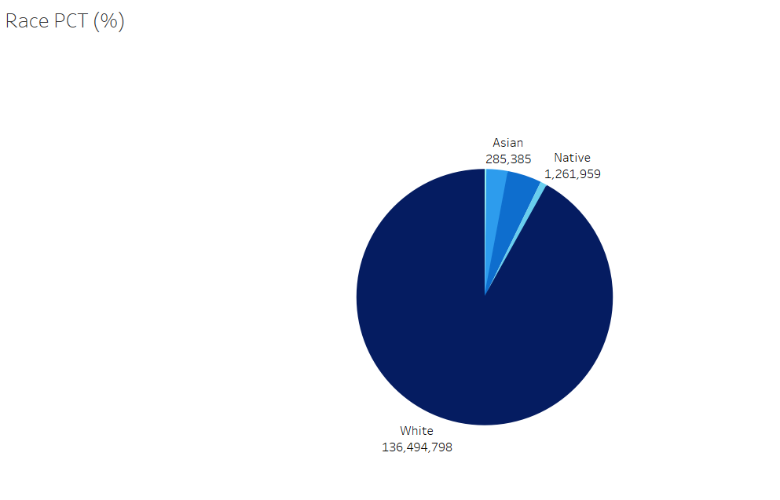
What is the racial composition of the population Across the US?
Dominant Race: The majority of the population is White, constituting approximately 97% of the total.
Minority Groups: Asian and Native populations make up a small percentage of the overall population.
Disparity as a reason for choice : There is a significant disparity in the representation of different racial groups, with White individuals being overwhelmingly dominant and the pie chart is great at showing this dominance.

Slide 10
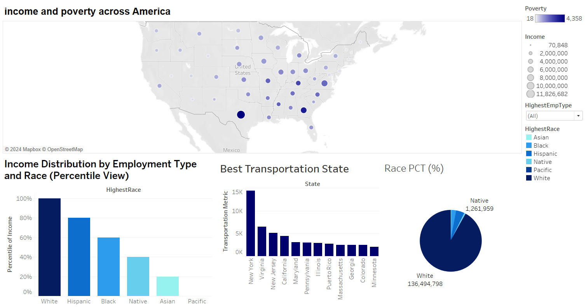

Slide 11

Thank You
Project Link

